Slide 1
The Death of Transit and Beyond
Geoff Huston
Chief Scientist, APNIC
May 2017

Slide 2
This presentation is not about any specific network details
Or specific plans
Or particular services
Or any particular technology
Or anything like that

Slide 3
It’s about architecture

Slide 4
It’s about architecture
And, in particular, about the evolution of network architecture in the Internet

Slide 5
It’s about architecture
And some thoughts about the implications of these changes in terms of public policies for the Internet

Slide 6
Our heritage
Our heritage

Slide 7
Our heritage
The Telephone Network:
The major technical achievement of the twentieth century
Connected handsets to handsets
The network was intentionally transparent
Real time virtual circuit support between connected edge devices
Network-centric architecture with minimal functionality in the edge devices

Slide 8
Computer Networks
Computer Networks

Slide 9
Computer Networks
The original concept for computer networks was like the telephone network:
The network was there to enable connected computers to exchange data
All connected computers were able to initiate or receive “calls”
A connected computer could not call ”the network” – the network was an invisible common substrate
It made no difference if the network had active or passive internal elements

Slide 10
Computer Networks
These networks were similar to telephone networks:
Connected computer to computer
The network was intentionally transparent
Computers were variously both clients and servers
And they were also different:
No requirement for real time synchronous transparency
Provided the opportunity to drop synchronicity and virtual circuits and use packet-based networking
This flexible form of network sharing enabled opportunities for higher efficiencies and lower costs

Slide 11
The Internet Architecture (c1980’s)
“End-to-End” design:
Connected computer to computer
The network switching function was stateless
No virtual circuits, no dynamic state for packets to follow
Single network-wide addressing model
Single network-wide routing model
Simple datagram unreliable datagram delivery in each packet switching element
hop-by-hop destination-address-based packet forwarding paradigm

Slide 12
IP Network
TCP/IP Engine
TCP/IP Engine
TCP hosts

Slide 13
The Result was Revolutionary!
Very Simple
Extraordinarily Cheap
Unbelievably Efficient
Highly Adaptable

Slide 14
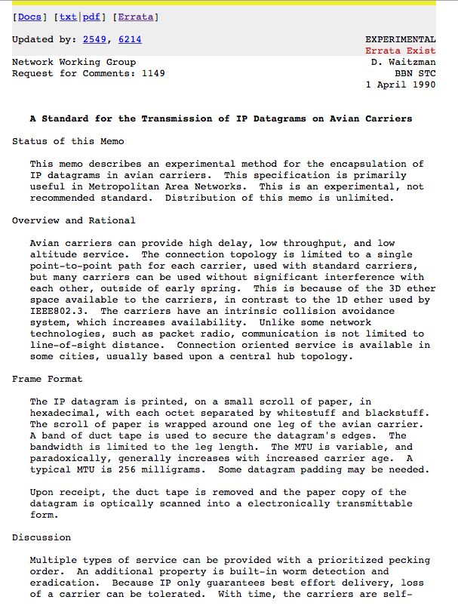

Slide 15
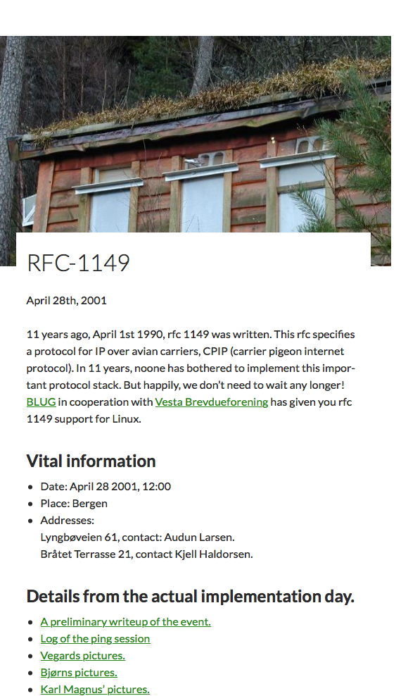
http://www.blug.linux.no/rfc1149

Slide 16
The Result was Revolutionary!
By stripping out network-centric virtual circuit states and removing time synchronicity the resultant carriage network was minimal in design and functionality
More complex functions, such as flow control, jitter stability, loss mitigation and reliability, were pushed out to the computers on the edge

Slide 17
Internet Evolution
In the regulated world of national telephone operators every telephone network was “equal”
But we rapidly started differentiating between Internet networks. Internet networks were not all the same.
We started differentiating on roles and services and started differentiating by the flow of revenues between networks

Slide 18
Internet Evolution
Financial considerations of the evolving commercial Internet introduced structure of the Network Provider interaction
Role specialization between access networks that serviced connection of edge devices and networks and transit networks that serviced interconnection of other networks
Limited forms of financial settlement in packet networks reduced interaction to either SKA peering or upstream Provider / downstream Customer

Slide 19
Network Role Segmentation

Slide 20
Edge Role Segmentation
Breaking the edge into clients and servers
Access networks service the needs “clients”
Clients are not directly reachable by other clients
Clients connect to services
The role of the network here is to carry clients to the service access point
The assumption here is that there are many more clients than service points
Clients pay the network for this carriage role

Slide 21
Content vs Carriage
Who pays whom?
The only reason why access networks have clients is because there are content services that clients want to access
Therefore carriage should pay for content
There is no “end-to-end” financial settlement model in the Internet – both “ends” pay for access and network providers settle between themselves. To a carriage network, content is just another client
Content should pay for carriage, just like any other client

Slide 22
Content vs Carriage
Who pays whom?
The only reason why access networks have clients is because there are content services that clients want to access
Therefore carriage should pay for content
There is no “end-to-end” financial settlement model in the Internet – both “ends” pay for access and network providers settle between themselves. To a carriage network, content is just another client
Content should pay for carriage, just like any other client
The content folk resolved this by going “over the top” and created relationships directly with end users

Slide 23
Content Server
Content Server

Slide 24
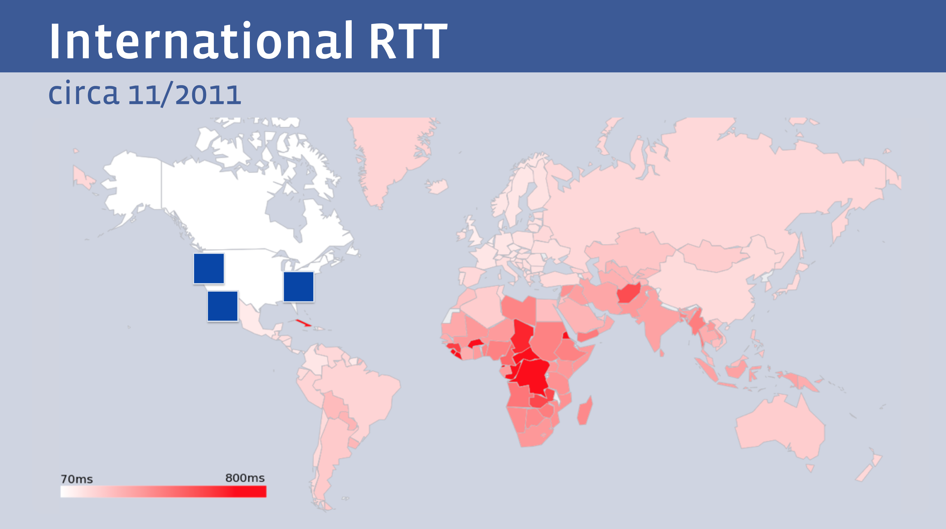
The Tyranny of Distance
But not all clients enjoy the same experience from a single service
Facebook presentation at NANOG 68

Slide 25
Content Distribution
Content Distribution Network

Slide 26
Let them eat data!
The rise of the Content Distribution Network
Replicate content caches close to large user populations
The challenge of delivering many replicant service requests over high delay network paths is replaced by the task of updating a set of local caches by the content distribution system and then serving user service requests over the access network
Reduced service latency, increased service resilience

Slide 27
Role Reversal
Service portals are located adjacent to users
Networks no longer carry users’ traffic to/from service portals as ISP public carriage services
Networks carry content to service portals as CDN private carriage services
This shift has some profound implications for the Internet

Slide 28
Who’s building now?
Almost all new submarine international cable projects are heavily underwritten by content providers, not carriers
Large content providers have huge and often unpredictable traffic requirements, especially among their own data centers. Their capacity needs are at such a scale that it makes sense for them, on their biggest routes, to build rather than to buy. Owning subsea fibre pairs also gives them the flexibility to upgrade when they see fit, rather than being beholden to a third-party submarine cable operator.”
Tim Stronge of Telegeography, January 2017

Slide 29
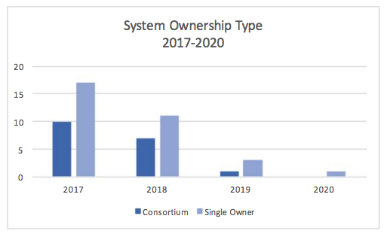
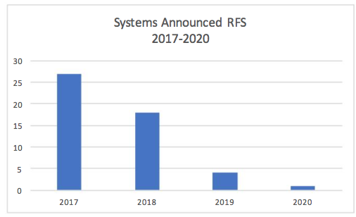
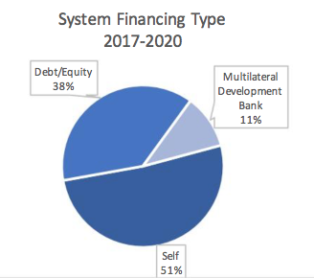
Submarine Cables
And those that are being built are now single owner cables
Fewer cables being built
And the majority are now self-funded

Slide 30
Today’s Internet Architecture
We’ve split the network into clients and servers
Web servers
Streaming servers
Mail servers
DNS servers
Servers and services now sit in CDN systems with global replication and DDOS resilience
Users don’t reach out to content any more - the CDNs bring content to users

Slide 31
Today’s Internet Architecture

Slide 32
Transit?
If users don’t send packets to users any more…
If content is now delivered via CDNs to users via discrete service cones…
If there is no universal service obligation…
Then why do we still need Transit Service providers?

Slide 33
Transit?
Once the CDN caches sit “inside” the Edge NAT of the Access ISP then the entire wide area network becomes a marginal activity compared to the value of the content feeds!

Slide 34
Internet Names and Addresses?
If the Internet is (or maybe soon will be) a collection of discrete private CDN service ‘cones’ then why do we still need :
A global address plan (in IPv4 or IPv6)?
A global name system?
A single global network?

Slide 35
It’s not just the death of Transit …
It’s the re-purposing of the entire network
Service provisioning sits within cloud providers and distributed data centres
Applications that use peer-to-peer networking are now under general suspicion of dark deeds of IPR theft
Edge computers are now acting as televisions into the clouded world of data
The distinction between personal and public data realms is disappearing into the realm of corporately owned private data empires

Slide 36
Exactly where are we?
We started this journey building a telephone network for computers to communicate between each other
One-way content distribution lies at the core of today’s Internet
We are now far closer to a model of broadcast television or some similar form of video / data distribution
This content distribution role is an enterprise model rather than a public service
The internal parts of the network are now being privatized and removed from public regulatory scrutiny

Slide 37
Policy?
If CDN networks are private networks, and there is little residual public carriage other than last mile access networks, then what do we really mean by “public communications policy”?
In the regulatory world ‘content’ is commerce, not carriage!

Slide 38
Policy?
In today’s Internet what do we mean in a policy sense by concepts such as:
“universal service obligation”
“network neutrality”
“rights of access” or even
“market dominance”
when we are talking about diverse CDNs as the dominant actors in the Internet?

Slide 39
Content is Aggregating
There are not thousands of content service platforms
There are just a few hundred
And the space are dominated by a smaller number of massive actors who set the environment for all others

Slide 40





The Large and the Largest
Company | $B USD
Apple | 753
Alphabet | 573
Microsoft | 503
Amazon | 423
Berkshire Hathaway | 410
Exxon Mobil | 339
Johnson & Johnson | 337
Facebook | 334
JP Morgan Chase | 313
Wells Fargo | 278
The world’s 10 largest publicly traded companies, as ranked by their market valuation, March 2017

Slide 41
Content is King
None of these five technology companies are a telephone company, or even a transit ISP, or even an ISP at all!
All of them have pushed aside carriage networks in order to maintain direct relationships with billions of consumers
These valuable consumer relationships are based on content services, not carriage

Slide 42
Competition or Cartel?
With a small number of truly massive enterprises at the heart of the area of digital content and service is this still a space that is shaped by competitive pressures?
Or do these dominant incumbents get to set their own terms of engagement with each other and with users?

Slide 43
We’ve been here before…

Slide 44
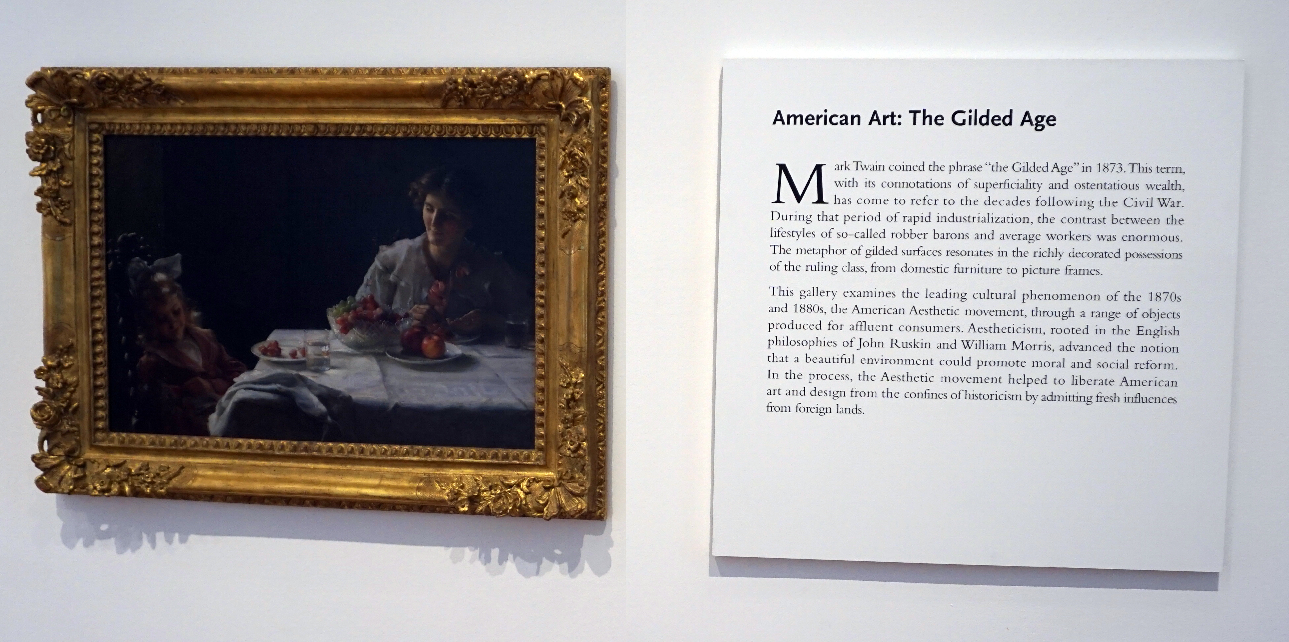
High Museum of Art, Atlanta

Slide 45
The Gilded Age
A term applied to America in the 1870 – 1890’s about the building of industrial and commercial corporate giants on platforms that were a mix of industrial innovation and enterprise with elements of greed, corruption and labor exploitation
Andrew Carnegie - US Steel
John Rockfeller - Standard Oil
Theodore Vail - AT&T
George Westinghouse – Rail Brakes
Thomas Edison – General Electric
J P Morgan - Banking

Slide 46
The Gilded Age
During this period in the United States the dominant position within industry and commerce was occupied by a very small number of players who were moving far faster than the regulatory measures of the day.
The resulting monopolies took the US decades to dismember, and even today many of these gilded age companies are dominant in their field

Slide 47
The Internet’s Gilded Age
At some point in the past decade or so the dominant position across the entire Internet has been occupied by a very small number of players who are moving far faster than the regulatory measures that were intended to curb the worst excesses of market dominance by a small clique of actors.

Slide 48
Who’s Gilding?
Company | $B USD
Apple | 753
Alphabet | 573
Microsoft | 503
Amazon | 423
Berkshire Hathaway | 410
Exxon Mobil | 339
Johnson & Johnson | 337
Facebook | 334
JP Morgan Chase | 313
Wells Fargo | 278

Slide 49
The Internet’s Gilded Age
These actors have enough market influence to set their own rules of engagement with:
Users,
Each other,
Third party suppliers,
Regulators and Governments
By taking a leading position with these emergent technologies, these players are able to amass vast fortunes, with little in the way of accountability to a broader common public good

Slide 50
The Internet’s Gilded Age
These actors have enough market influence to set their own rules of engagement with:
Users,
Each other,
Third party suppliers,
Regulators and Governments
By taking a leading position with these emergent technologies, these players are able to amass vast fortunes, with little in the way of accountability to a broader common public good
Is this the Internet we were dreaming of?

Slide 51
What is this all about?
This is no longer just a conversation about changes in carriage and communications within the Internet.
It is probably not even a conversation about carriage and communications at all.

Slide 52
What is this all about?
The changing face of the Internet is no longer a matter of public communications, but a matter of public services.
And with this observation we are back to a more basic theme…

Slide 53
What is this all about?
The essential topic of this conversation is how we can strike a sustainable balance between a rapacious private sector that has amassed overarching control of the digital service and content space, and the needs of the larger society in which we all would like some equity of opportunity to thrive and benefit from the outcomes of this new digital age.

Slide 54
Thanks!

