Slide 1
The Death of Transit and Beyond
Geoff Huston
Chief Scientist, APNIC

Slide 2
This presentation is not about details
Or specific plans
Or particular services
Or any particular technology
Or anything like that

Slide 3
It’s about architecture
And, in particular, about the evolution of network architecture in the Internet
And some thoughts about the implications of these changes in terms of public policies

Slide 4
Our heritage
Our heritage
The Telephone Network:
  The major technical achievement of the twentieth century
  Connected handsets to handsets
  The network was intentionally transparent
  Real time virtual circuit support between connected edge devices
  Network-centric architecture with minimal functionality in the edge devices
The Telephone Network:
  The major technical achievement of the twentieth century
  Connected handsets to handsets
  The network was intentionally transparent
  Real time virtual circuit support between connected edge devices
  Network-centric architecture with minimal functionality in the edge devices

Slide 5
Computer Networks
The rise of digital networks for computers
  No requirement for real time synchronous transparency
  Provided the opportunity to drop synchronicity and virtual circuits and use packetised comms
    Packet Data Networking allowed us to realise opportunities for higher efficiencies and lower costs
  Connected computer to computer
  The network was intentionally transparent
  Edge computers were variously both clients and servers

Slide 6
The Internet Architecture (c1980’s)
“End-to-End” design:
  Connected computer to computer
  The network switching function was stateless
    No virtual circuits, no dynamic state for packets to follow
  Single network-wide addressing model
  Single network-wide routing model
  Simple datagram unreliable datagram delivery in each packet switching element
  hop-by-hop destination-address-based packet forwarding paradigm

Slide 7
TCP/IP Engine
TCP/IP Engine

Slide 8
The Result was Revolutionary!
Very Simple
Extraordinarily Cheap
Unbelievably Efficient
  By stripping out network-centric virtual circuit states and removing time synchronicity the resultant carriage network was minimal, while more complex functions such as flow control and reliability were pushed out to the computers on the edge

Slide 9
Internet Evolution
Financial considerations of the evolving commercial Internet introduced structure of the Network Provider interaction
  Role specialization between access networks that serviced connection of edge devices and networks and transit networks that serviced interconnection of other networks
  Limited forms of financial settlement in packet networks reduced interaction to either SKA peering or upstream Provider / downstream Customer

Slide 10
Network Role Segmentation

Slide 11
Edge Role Segmentation
Breaking the edge into clients and servers
  Access networks service the needs “clients”
  Clients are not directly reachable by other clients
  Clients connect to services
  The role of the network here is to carry clients to the service access point
  The assumption here is that there are many more clients than service points
  Clients pay the network for this carriage role

Slide 12
Content vs Carriage
Who pays whom?
  The only reason why access networks have clients is because there are content services that clients want to access
    Therefore carriage should pay for content
  There is no “end-to-end” financial settlement model in the Internet – both “ends” pay for access and network providers settle between themselves. To a carriage network, content is just another client
    Content should pay for carriage, just like any other client

Slide 13
Content vs Carriage
Who pays whom?
  The only reason why access networks have clients is because there are content services that clients want to access
    Therefore carriage should pay for content
  There is no “end-to-end” financial settlement model in the Internet – both “ends” pay for access and network providers settle between themselves. To a carriage network, content is just another client
    Content should pay for carriage, just like any other client
The content folk resolved this by going “over the top” and created relationships directly with end users

Slide 14
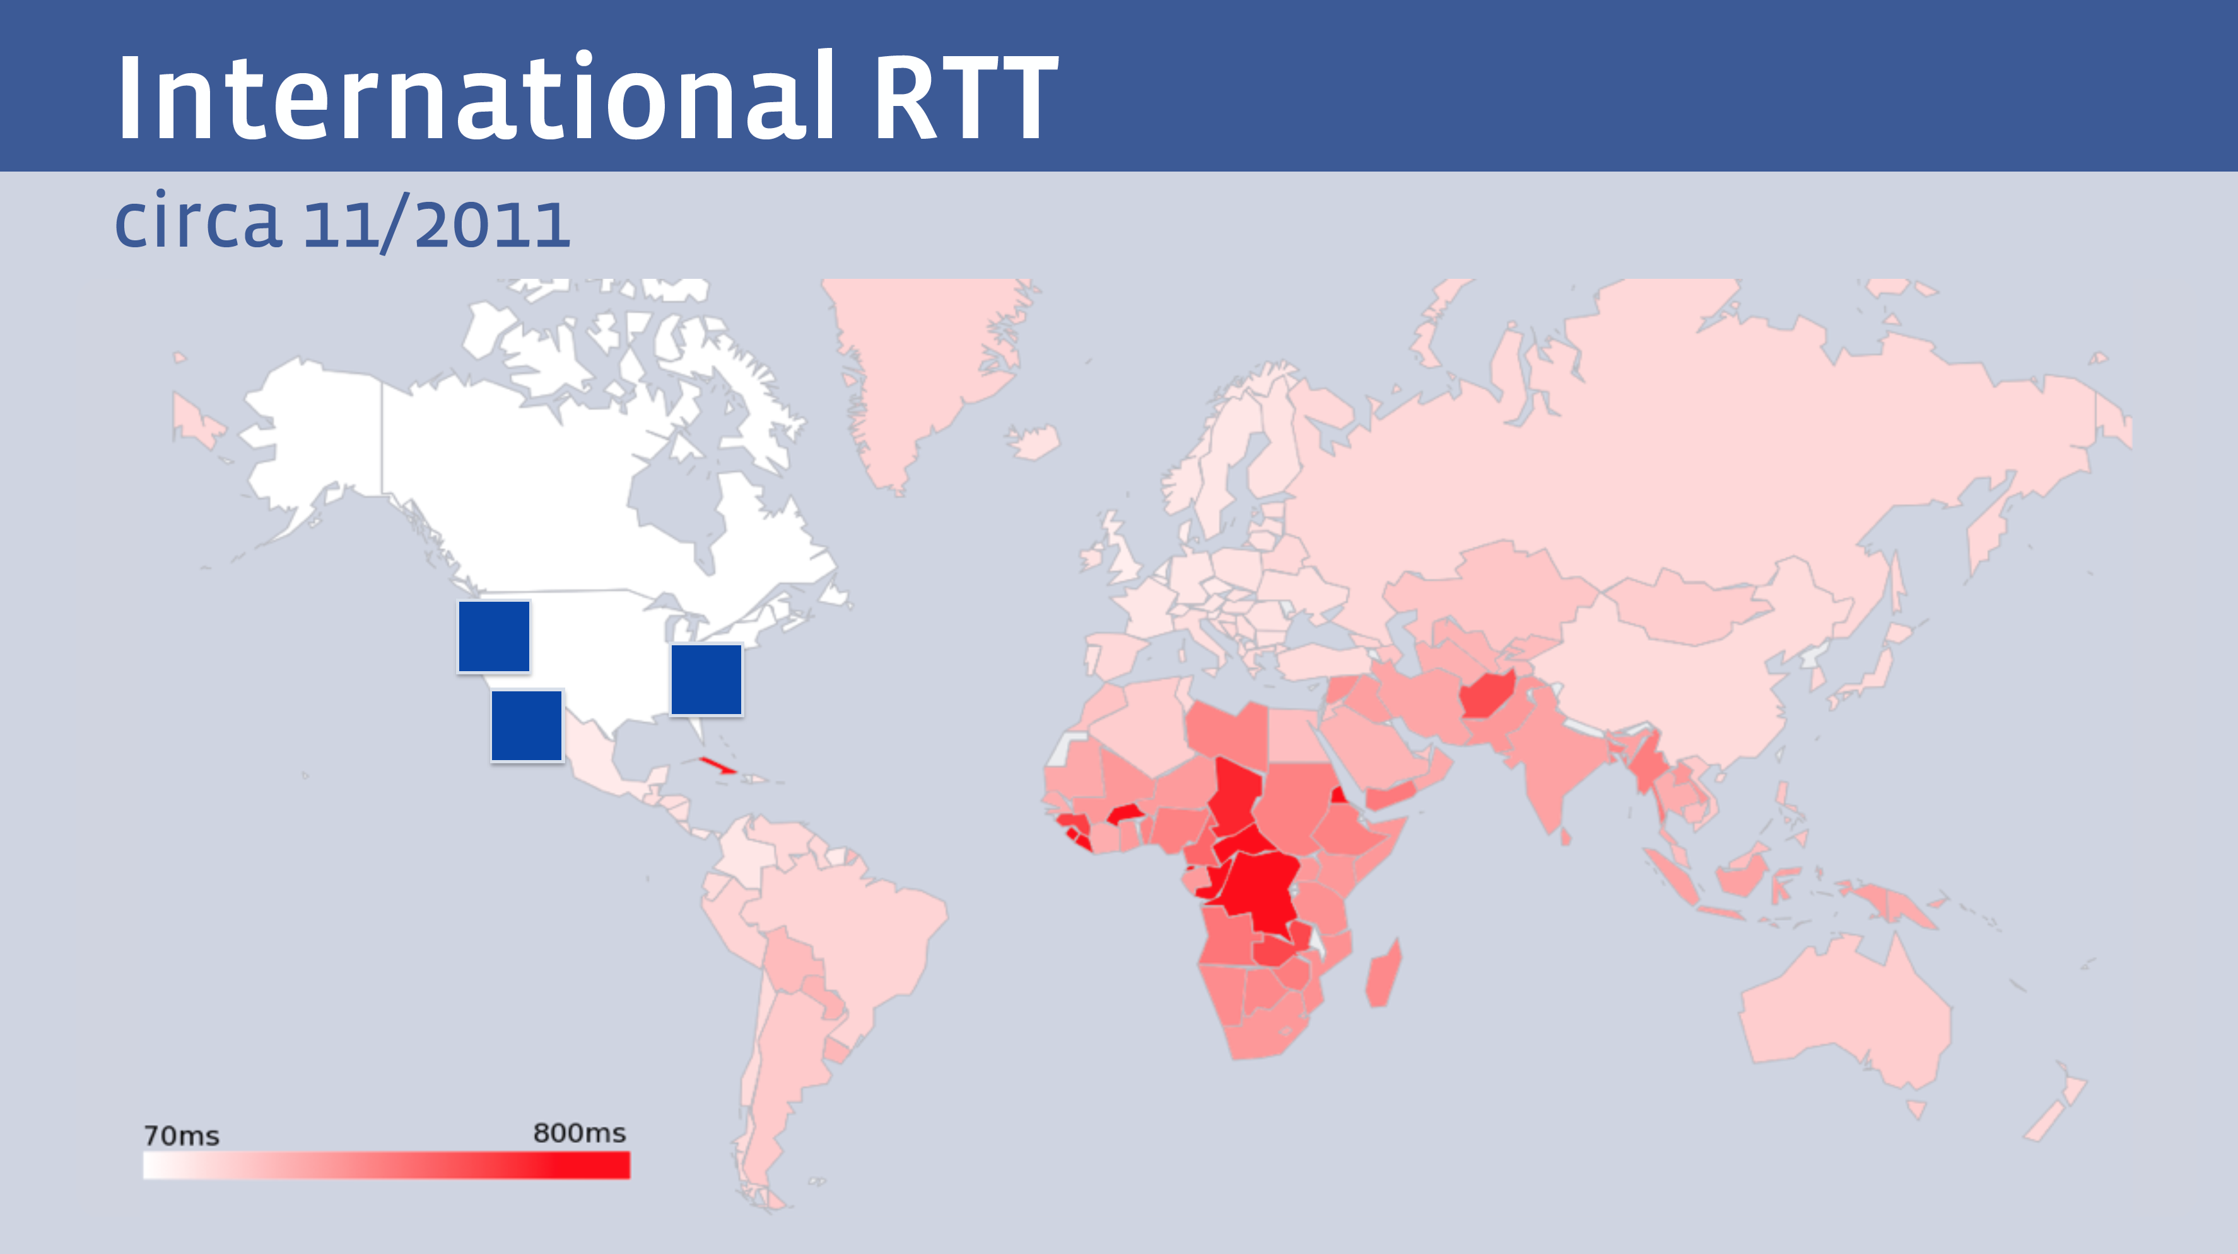
The Tyranny of Distance
  But not all clients enjoy the same experience from a single service
Facebook presentation at NANOG 68

Slide 15
Let them eat data!
The rise of the Content Distribution Network
  Replicate content caches close to large user populations
  The challenge of delivering many replicant service requests over high delay network paths is replaced by the task of updating a small set of local caches by the content distribution system and then serving user service requests over the access network
  Reduced service latency, increased service resilience

Slide 16
Who’s building now?
Almost all new submarine international cable projects are heavily underwritten by content providers, not carriers
Large content providers have huge and often unpredictable traffic requirements, especially among their own data centers. Their capacity needs are at such a scale that it makes sense for them, on their biggest routes, to build rather than to buy. Owning subsea fibre pairs also gives them the flexibility to upgrade when they see fit, rather than being beholden to a third-party submarine cable operator.”
Tim Stronge of Telegeography

Slide 17
Today’s Internet Architecture
We’ve split the network into clients and servers
  Web servers
  Streaming servers
  Mail servers
  DNS servers
Servers and services now sit in CDN systems with global replication and DDOS resilience
Users don’t reach out to content any more - the CDNs bring content to users

Slide 18
Today’s Internet Architecture

Slide 19
Transit?
If users don’t send packets to users any more
If content is now delivered via CDNs to users via discrete service cones
If there is no universal service obligation
Then why do we still need Transit Service providers?

Slide 20
Transit?
Once the CDN caches sit “inside” the Edge NAT of the Access ISP then the entire wide area network becomes a marginal activity compared to the value of the content feeds!
If the Internet is (or maybe soon will be) a collection of discrete private CDN service ‘cones’ then why do we still need :
  A global address plan?
  A global name system?
  A single global network?

Slide 21
It’s not just the death of Transit …
It’s the re-purposing of the entire network
  Service provisioning sits within cloud providers and distributed data centres
  Applications that use peer-to-peer networking are now under general suspicion of dark deeds of IPR theft
  Edge computers are now acting as televisions into the clouded world of data
  The distinction between personal and public data realms is disappearing into the realm of corporately owned private data empires

Slide 22
Where are we?
We started this journey building a telephone network for computers to communicate between each other
But today one way content distribution lies at the core of today’s Internet
We are now far closer to a model of broadcast television or some similar form of video / data distribution
This content distribution role is an enterprise model rather than a public service
The internal parts of the network are now being privatized and removed from public regulatory scrutiny

Slide 23
Policy?
If CDN networks are private networks, and there is little residual public carriage other than last mile access networks, then what do we really mean by “public communications policy”?
In the regulatory world ‘content’ is commerce, not carriage!

Slide 24
Policy?
In today’s Internet what do we mean in a policy sense by concepts such as “universal service obligation” “network neutrality” “rights of access” or even “market dominance” when we are talking about diverse CDNs as the dominant actors in the Internet?

Slide 25
The Internet’s “Gilded Age”*
At some point in the past decade or so the dominant position across the entire Internet has been occupied by a very small number of players who are moving far faster than the regulatory measures that were intended to curb the worst excesses of market dominance by a small clique of actors.
* look it up on Google!

Slide 26
The Internet’s “Gilded Age”
These actors have enough market influence to set their own rules of engagement with:
  Users,
  Each other,
  Third party suppliers,
  Regulators and Governments
By taking a leading position with these emergent technologies, these players are able to amass vast fortunes, with little in the way of accountability to a broader common public good

Slide 27
The Internet’s “Gilded Age”
These actors have enough market influence to set their own rules of engagement with:
  Users,
  Each other,
  Third party suppliers,
  Regulators and Governments
By taking a leading position with these emergent technologies, these players are able to amass vast fortunes, with little in the way of accountability to a broader common public good
Was this the Internet we were dreaming of?

Slide 28
Thanks!

